Slide 1
Diagnostics Related to the
Unwanted Beam
Pavel Evtushenko, Jlab FEL

Slide 2
Flavors of Unwanted beam
Four sorts of the unwanted beams
Fraction of the phase space distribution that is far away from the core (due to the beam dynamics)
Low charge due to not well attenuated Cathode Laser (ERLs) – but real bunches that have proper timing for acceleration
Due to the Cathode Laser but not properly timed (scattered and reflected light)
Field emission: Gun (can be DC or RF), Accelerator itself (can be accelerated in both directions)

Slide 3
For the number 2-4
First of all prevent as much as possible
Take care of the Cathode Laser going out of the gun
Use Brewster angle windows (polarization) or coatings (still 10⁻⁴)
Cathode that scatters less (optically flat) (requirement?)
Having load lock would help to keep cathode in optically good condition
Non UV cathodes (green) more favorable
Extinction ration of the EO cells: high and stable
Field emission … well … either it system is built well, or you run limited by FE (just so that you can tolerate it)

Slide 4
For the number 1
Linacs with average current 1-2 mA and energy 1-2.5 GeV are envisioned as drivers for next generation high average brightness Light Sources (up to 5 MW beam power) vs. presently operational linac based X-ray sources 24 uA (FLASH) and 15 nA (LCLS)
JLab IR/UV Upgrade is a 9 mA ERL with average beam power
of 1.2 MW – provides us with operational experience of high current linac and is a good testing ground for future development
Halo - parts of the phase space with large amplitude and small intensity - is one of the limitations for high current linacs
Linac beams have neither the time nor the mechanism to come to equilibrium (unlike storage rings, which also run high current)
Besides Light Sources there is a number of linac application requiring high current operation with low or no beam halo
Notes:
The motivation for this program comes from two directions:
On one hand Linacs with the average current …
On the other hand there are existing facilities such as Jefferson Lab FEL that is a high current high average beam power machine that have demonstrated operation with average current of up to 9 MeV and beam power

Slide 5
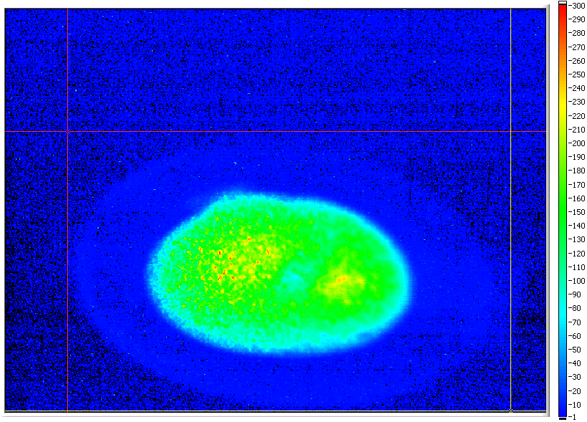
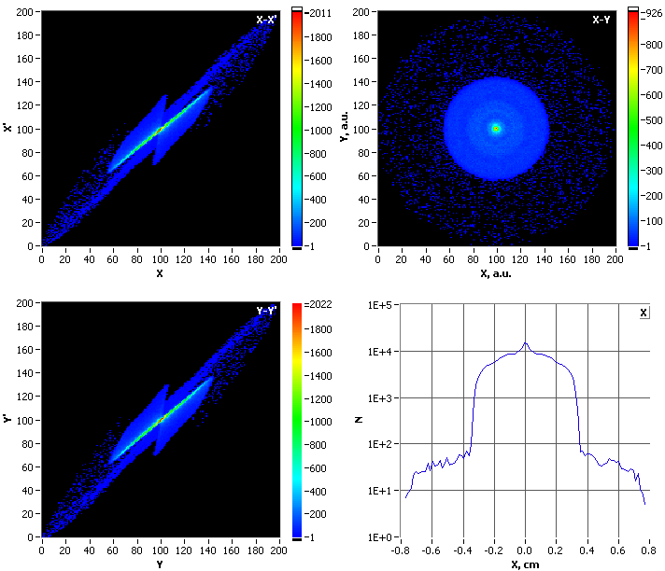
Measurements vs. Modeling at the level ~10³
Measured in JLab FEL injector,
local intensity difference of the
core and “halo” is about 300.
(500 would measure as well)
10-bit frame grabber & a CCD
with 57 dB dynamic range
PARMELA simulations of the same setup with 3E5 particles:
X and Y phase spaces, beam profile and its projection show
the halo around the core of about 3E-3.
Even in idealized system (simulation) non-linear beam
dynamics can lead to formation of halo.

Slide 6
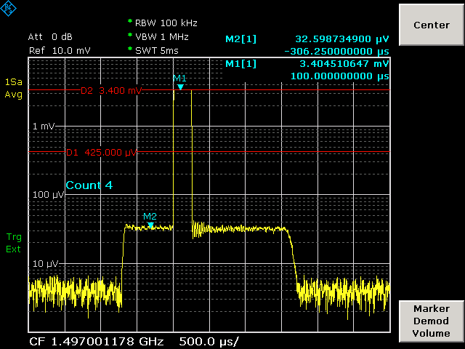
Drive Laser “ghost” pulses
Using a Log-amp is an easy way to diagnose presence of the “ghost” pulses
Log-amps with dynamic range 100 dB are available
631 uA (100%)
135 pC x 4.678125 MHz
5.7 uA (~0.9 %)
37.425 MHz “ghost”
pulses

Slide 7
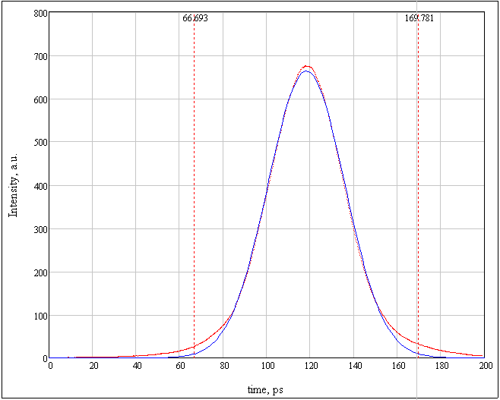
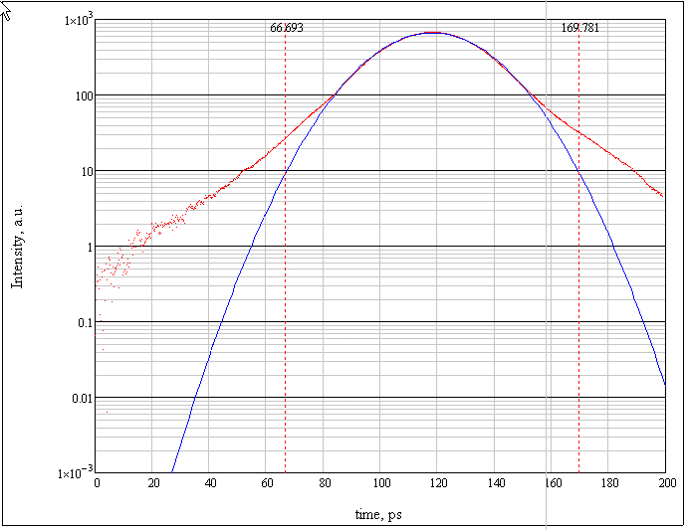
Cathode Laser pulse via streak camera
appears to be close to Gaussian on linear scale; tails not so much Gaussian
the difference from Gaussian distribution is obvious on log scale
realistic (measured) distribution must be used for realistic modeling
especially is the calculations are intended for large dynamic range effects

Slide 8
“The Grand Scheme”
I. Transverse beam profile measurements with LDR
Wire scanner
LDR imaging
CW laser wire
Coronagraph
II. Transverse phase space measurements with LDR
III. Longitudinal phase space with LDR (in injector at 9 MeV)
Drive Laser LDR
measurements
to start modeling with LDR and real
Initial conditions
transverse
longitudinal
cathode Q.E. 2D
Tomography – where linear optics work (135 MeV)
Time resolving laser wire
(Thomson scattering, CW)
Scanning slit - space charge dominated beam (9 MeV)
Transverse kicker cavity + spectrometer + LDR imaging
IV. High order optics
to manipulate halo
V. Beam dynamics modeling with LDR

Slide 9
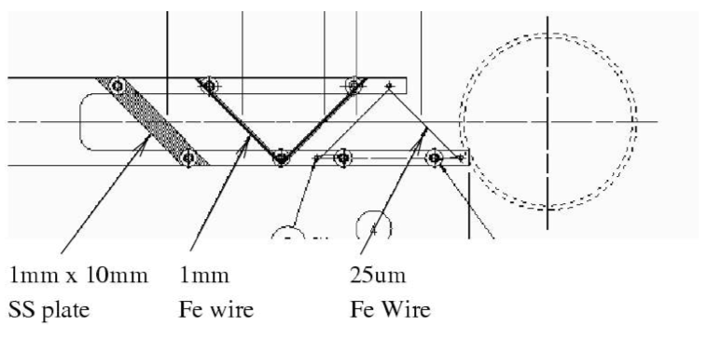
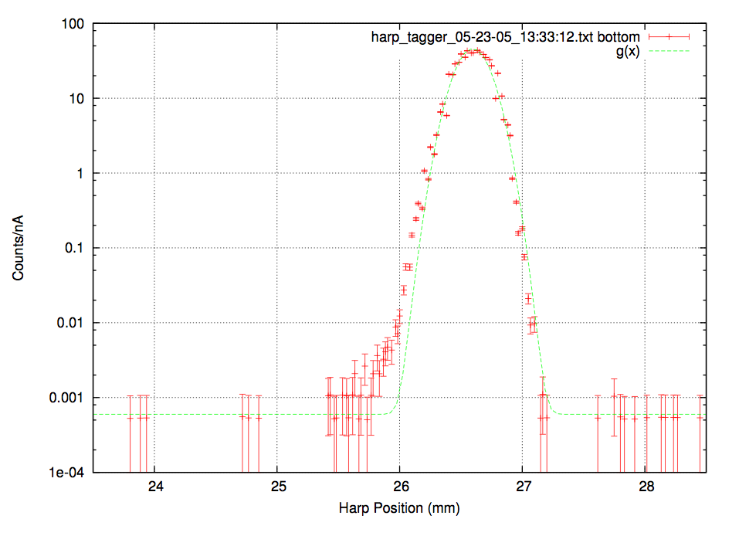
Wire scanner measurements
A. Freyberger, CEBAF measurements, in DIPAC05 proceedings
wire with diameter much smaller than the beam size interacts with beam as it is scanned across it
there is a number of interaction mechanisms:
beam capture
secondary emission
scattering
conversion
different ways to detect the signal
induced current
secondary particles (counting)
only 1D projections of 2D distributions
takes time (“patience limited”)
real LINAC beams – non-equilibrium

Slide 10
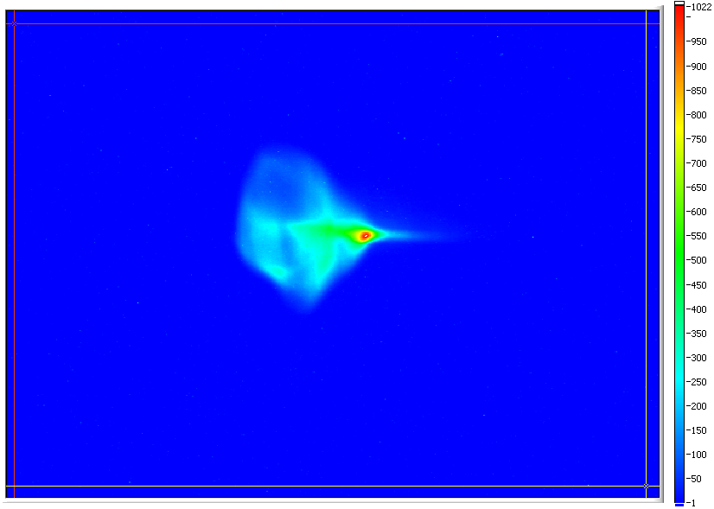
Wire scanner measurements
A. Freyberger, CEBAF measurements, In DIPAC05 proceedings
wire with diameter much smaller than the beam size interacts with beam as it is scanned across it
there is a number of interaction mechanisms:
beam capture
secondary emission
scattering
conversion
different ways to detect the signal
induced current
secondary particles (counting)
only 1D projections of 2D distributions
takes time (“patience limited”)
real LINAC beams – non-equilibrium
at JLab FEL

Slide 11
Large Dynamic Range imaging (1)
To explain the idea we consider JLab FEL tune-up beam and the use of OTR.
Beam – 250 μs macro pulses at 2 Hz, bunch rep. rate ~ 4.678 MHz, 135 pC bunch charge, ~ 158 nC integrated charge (limits the beam power to safe level)
With typical beam size of few hundred μm OTR signal is attenuated by ~ 10 to keep CCD from saturation. For phosphor or YAG:Ce viewers attenuation of at least 100 is used. Insertable ND1 and ND2 filters are used.
Quantitative OTR intensity measurements agrees well with calculations – well understood
With OTR there is enough intensity to measure 4 upper decades. Lower two decades need gain of about 100 to be measured.
The main principle is to use imaging with 2 or 3 sensors with different effective gain simultaneously and to combine data in one LDR image digitally
The key elements:
image intensifiers (necessary gain and higher is available)
accurate alignment and linearity
the algorithm, data overlap from different sensors
understanding CCD well overflow - transverse extend
Diffraction Effects in the optical system

Slide 12
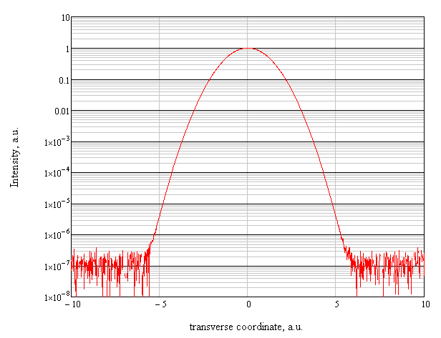
Large Dynamic Range imaging (2)
To be measured with
imaging sensor #1
and attenuation ~ 10
Intensity range that can
be measured now with
no additional gain.
To be measured with
imaging sensor #2
and gain ~ 200
Intensity range where
additional gain of ~ 100
is needed

Slide 13
Large Dynamic Range imaging (3)
To be measured with
imaging sensor #1
and attenuation ~ 10
Intensity range that can
be measured now with
no additional gain.
To be measured with
imaging sensor #2
and ~ no gain
Intensity range where
additional gain of ~ 100
is needed
To be measured with
imaging sensor #3
and gain ~ 200

Slide 14
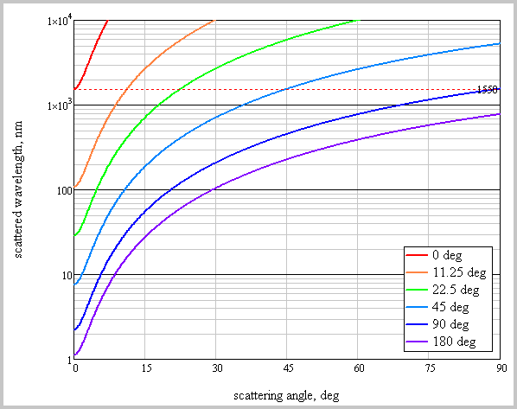
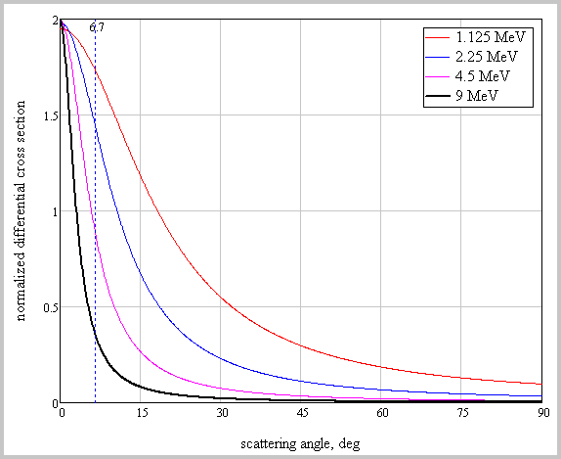
CW laser wire (1)
wavelength conversion assuming:
beam energy 9 MeV
laser wavelength 1.55 μm
differential cross section
(angular extent dependence
on the beam energies)
initial wavelength
1.55 μm

Slide 15
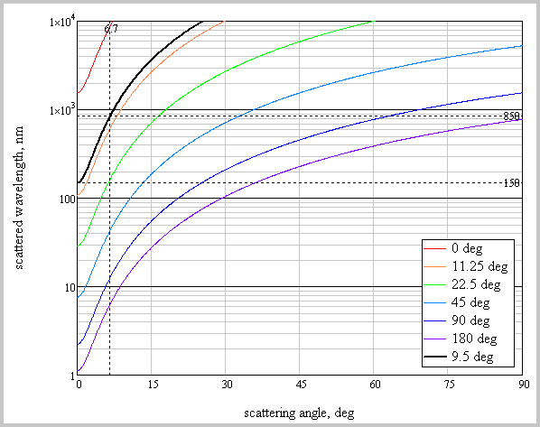
CW laser wire (2)
wavelength conversion assuming:
beam energy 9 MeV
laser wavelength 1.55 μm
differential cross section
(angular extend dependent
on the beam energies)
wavelength range:
150 nm – 850 nm
(to stay out of VUV
And be able to use
PMTs)

Slide 16
CW laser wire (3)
wavelength conversion assuming:
beam energy 9 MeV
laser wavelength 1.55 μm
photon rate
Assuming:
bunch charge 135 pC
laser wavelength 1.55 μm
pulse energy ~7 nJ
τ_{laser} 500 fs
τ_{beam} 2.5 ps
f_{beam} 9.356 MHz
r_{laser} 100 μm
We get N_{s}=0.02, but f_{s}=174 kHz !
There is factor of ~ 100 to be lost,
but there is also factor of ~100 to be
gained by pulse stacking.
Plus lock-in amplifier improves SNR as:
wavelength range:
150 nm – 850 nm
(to stay out of VUV
And be able to use
PMTs)

Slide 17
Conclusion / Outlook
The general approach of the program is the to:
develop and built diagnostics tools
study beam dynamics (phase space evolution)
implements beam optics for better manipulation of the halo
use the experimental data for modeling that is close to reality in sense of initial conditions (iterate between the experiments and the modeling)

Slide 18
JLab IR/UV ERL Light Source
E_{beam} 135 MeV
Bunch charge: 60 pC – UV FEL
135 pC – IR FEL
Rep. rate up to 74.85 MHz
25 μJ/pulse in 250–700 nm UV-VIS
120 μJ/pulse in 1-10 μm IR

